Slide 1



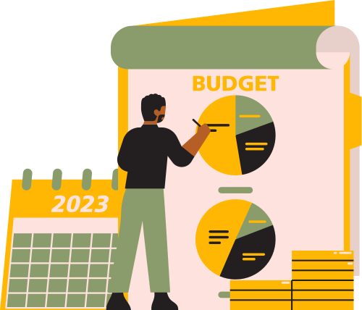

EXPENSE TRACKER
NAME : GANDHI DHAIRYA
ENROLL : 23002171310048
ROLL_NO : 90
BATCH : D3
“Managing Money Wisely”

Slide 2



INTRODUCTION
Expense management is an important process in daily life that involves organizing, monitoring and controlling finances. By managing money well, we can achieve short-term and long-term financial goals, and reduce financial stress.

Slide 3



WORKING
It is a personal finance management tool . It allows users to track expenses, set budget limits, and receive overspending alerts. Users can add bill reminders and get notifications for upcoming due payments. It also features investment tracking, simulating price changes and displaying performance trends. It includes data visualization with pie charts for expenses and line charts for investments using Matplotlib. Investment data is saved persistently in text and JSON files. The GUI has multiple tabs for easy navigation and management of finances.

Slide 4
FUTURE SCOPE
Cloud Storage & Syncing – Implement cloud-based storage to sync expenses across multiple devices.
Automated Expense Tracking – Integrate with bank APIs to fetch and categorize transactions automatically.
AI-Based Budgeting Insights – Use AI to analyze spending patterns and provide smart financial advice.
Mobile App Integration – Develop a mobile version or integrate with existing finance apps for better accessibility.

Slide 5


ADVANTAGES
Better Financial Management – Helps users track spending, categorize expenses, and stay within budget.
Expense Awareness – Provides insights into spending habits, reducing unnecessary expenses.
Bill & Payment Reminders – Prevents late payments by alerting users about upcoming bills.
Data-Driven Decisions – Visual reports (charts & graphs) help in making informed financial choices.
Savings & Investment Planning – Encourages saving by setting financial goals and tracking investments.

Slide 6
DISADVANTAGES
No Automation – Requires manual entry of expenses, unlike apps that sync with bank accounts.
Limited Data Security – Stores data in local text and JSON files, making it vulnerable to loss or unauthorized access.
No Multi-User Support – Cannot be used by multiple users or synced across devices.
Basic Investment Tracking – Simulated investment performance lacks real-time market data integration.

Slide 7

CONCLUSION
“WITH GOOD PLANNING AND THE RIGHT STEPS, YOU CAN CREATE A BRIGHTER AND MORE STABLE FINANCIAL FUTURE”

Slide 8


THANK YOU

